Slide 1
Ied mini_project Morse code keyer design
Section 06
Saaif Ahmed, Leon Li
6/16/20

Slide 2
Introduction
Introduction
Morse Code basic knowledge (problem identifying)
Technic specification and product feature
Design concept of Keyer model
Main circuit design and LTSpice simulation
Physical circuit build, test, and electronic specification
Q&A

Slide 3

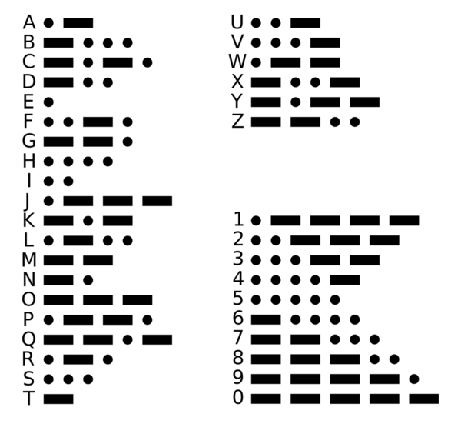

Morse code basic knowledge and design specification
The Morse code is represent by two different signals dot(short) signal and dash(long) signal.
The dot signal is one time unit
(our design is 0.17 seconds)
Space between the signal is one time unit
(our design is 0.17 seconds)
The dash signal is three time units
(our design is 0.50 seconds)
Space between the letter is three time units
(our design is 0.50 seconds)
Space between word is seven time units
(our design is 1.17 seconds)
Requirement for our Morse code keyer design typing speed is 5-40 words per minute. The average English word is 4.7 letters, average letter is 3.2 Morse codes.
Our design will allowed user to input, on average,16.8 words
per minute

Slide 4


Product Features
Technical specification for customer need
Customer Needs | Technical Specification
 | Metric | Target Value / Range of Values | Actual Value / Range of Values
Sound safety | Noise Level | 70 dB Max | 56 dB
User Comfort | Device weight | 1-10 kg | 3 kg
Size – adult can handle by one hand | Height x width x length | Up to 50 x 100 x 200 mm | 25 x 70x 170 mm
Typing speed limit | Input rate | 5-40 words per minute | 17 words per minute
Clear Signal | Time difference between “dot” and “dash” signal | 1 x “dash signal” time = 3 x “dot signal” time | 1x “dash signal” time = 3 x “dot signal” time
Electric safety | Device voltage level | Less than 30 volts | 5 volts
Open source | Customizable | Easily dissemble/assemble case deign
User can input repeat signal by holding the signal key rather than clicking the same signal key multiple times
The LEDs function as a timer for the person keying. They can release when they turn off to keep time.
LED indicator can also let people with hearing disability to utilize the keyer.
Easily dissemble/assemble case design provide open source for user with basic circuit knowledge adjust the timing by change the capacitor on the circuit.

Slide 5
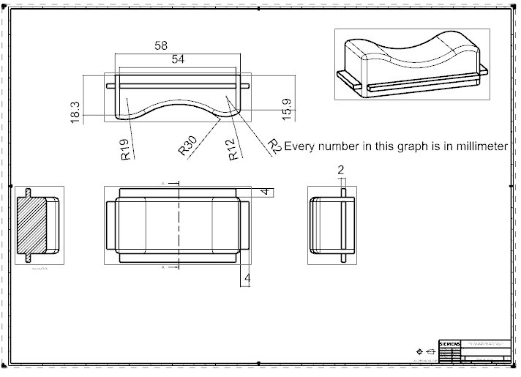
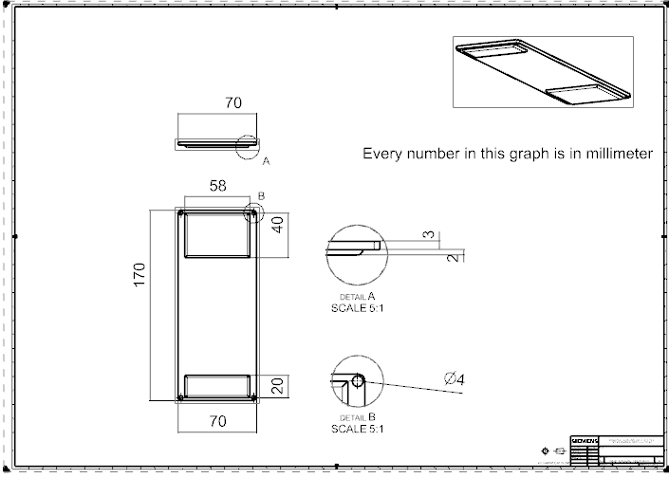
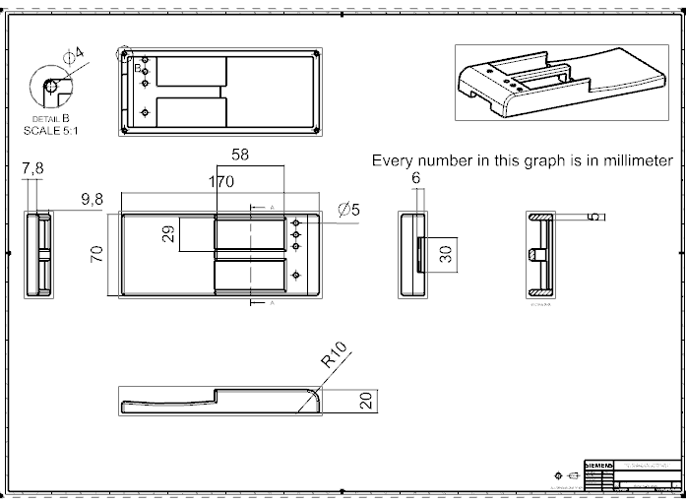
Design concept of keyer model
Removable bottom
1x main keyer perimeter: Length * Width*Height 170*70*20 mm (about the size of normal computer mice).
2x Input key assembled to main keyer and connected to push button on the circuit board.
1x removable bottom connected to main keyer part with 4x 4mm screws.
The material for main keyer and removable bottom are carbon steel (Durable and increase the weight for stability)
The material for Input key is carbon fiber (Durable and light weight to avoid the mistake input)
Two rubbers (width*length*thickness: 58*40*2 mm & 58*20*2mm) are attached to removable bottom to increase the friction between the desk and Keyer.
Input key
Main keyer

Slide 6
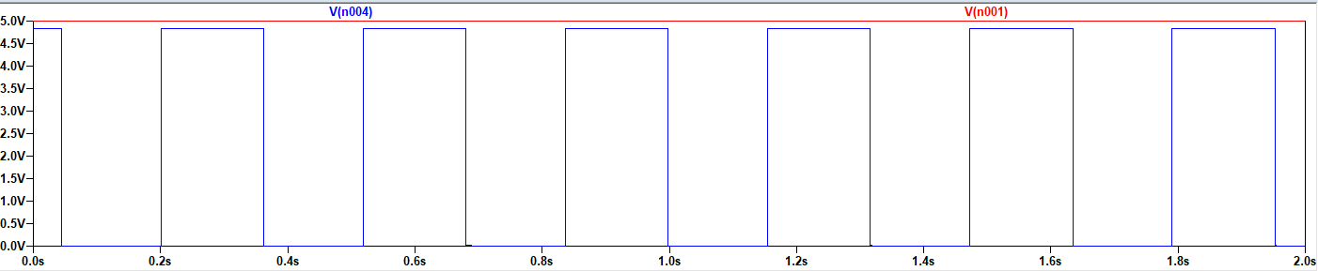
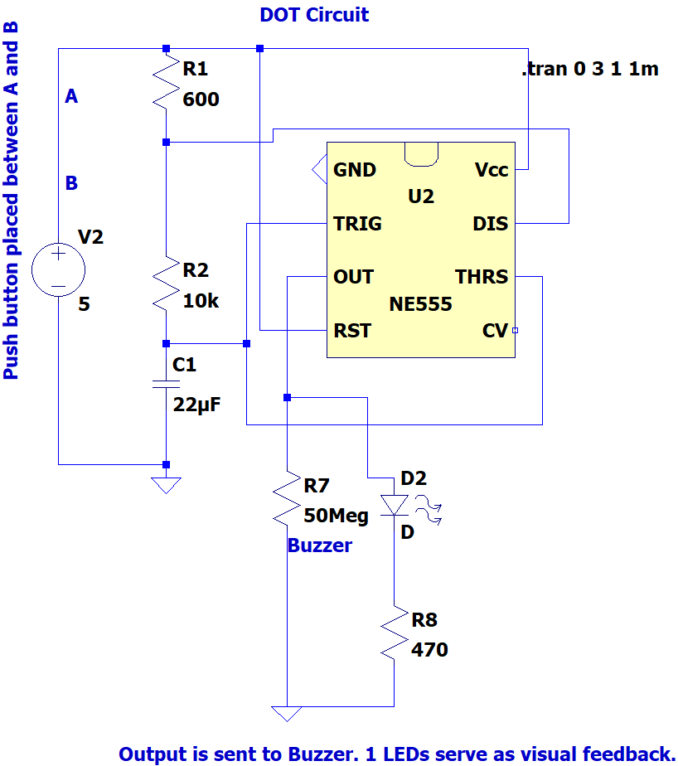
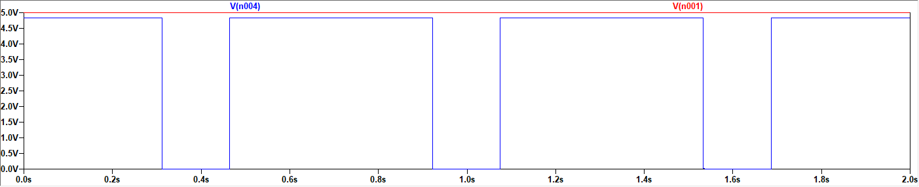
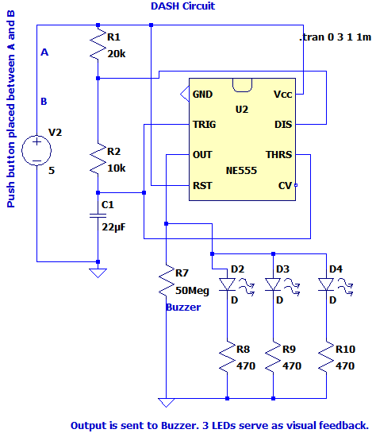
Main circuit design
Input for both circuits are 5V DC voltage
Outputs are connect to the Buzzer and LED indicators (1 for DOT circuit, 3 for DASH circuit)
In order to ensure the circuit can provide the accurate time units for DOT and DASH signals our deign adopted the 555 CN Timer to control the High (5V output voltage) and Low (0V output voltage)
The equations for 555 CN timer timing control and component specification:
High time:
T(s) = 0.69*(R1[Ohm] +R2[Ohm])*C1[Farad]
Low time:
T(s) = 0.69*R2[Ohm]*C[Farad]
DOT circuit: R1 = 600 Ohm, R2 = 10k Ohm, C1 = 22 uF.
DASH circuit: R1 = 600 Ohm, R2 = 10k Ohm, C1 = 22 uF.
LTSpice simulation for DOT circuit
V(n001): Input 5V DC voltage
V(n004): Output voltage
LTSpice simulation for DASH circuit
V(n001): Input 5V DC voltage
V(n004): Output voltage

Slide 7
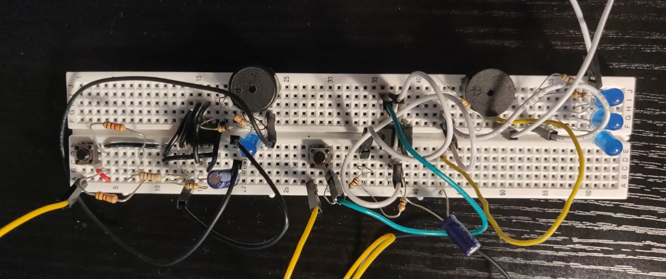
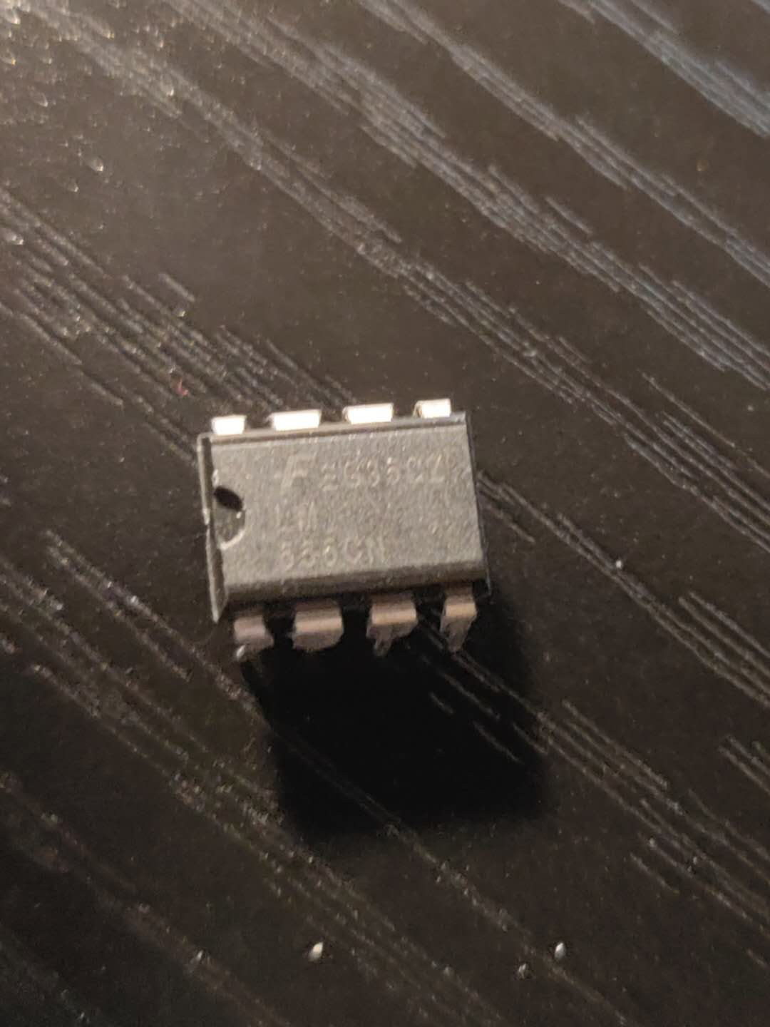
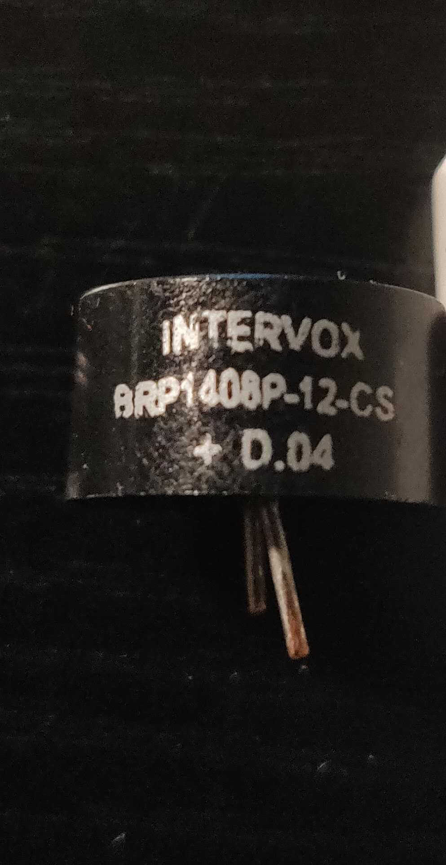
Physical circuit build, test, and electronics specification
2x EG350Z LM 555 CN timers
2x INTERVOX BRP1408P-12-CS Buzzers
4x Analog Device Blue LEDs
2x 22 uF Analog Device capacitors
1x 100 Ohm Analog Device resistor
4x 470 Ohm Analog Device resistors
2x 1k Ohm Analog Device resistors
2x 10k Ohm Analog Device resistors
1x 20k Ohm Analog Device resistor
All resistors are 5% tolerance. (Gold Band)
2x ELEGOO Push button.
Additional 2x 47k Ohm resistors in series with every buzzer to decrease the sound of buzzer from 95dB to 56dB

Slide 8

Thanks

